Slide 1

Mini Project
TOPIC:
Whatsapp
Mood
Detection

Slide 2
INTRODUCTION
I proudly present to you My Project Brief Summary . A summarized overview of the full and final plan can be easily presented to you by Me. This project designed exclusively by RUDRA PRATAP SINGH. Under ms. Neelam Rawat.

Slide 3
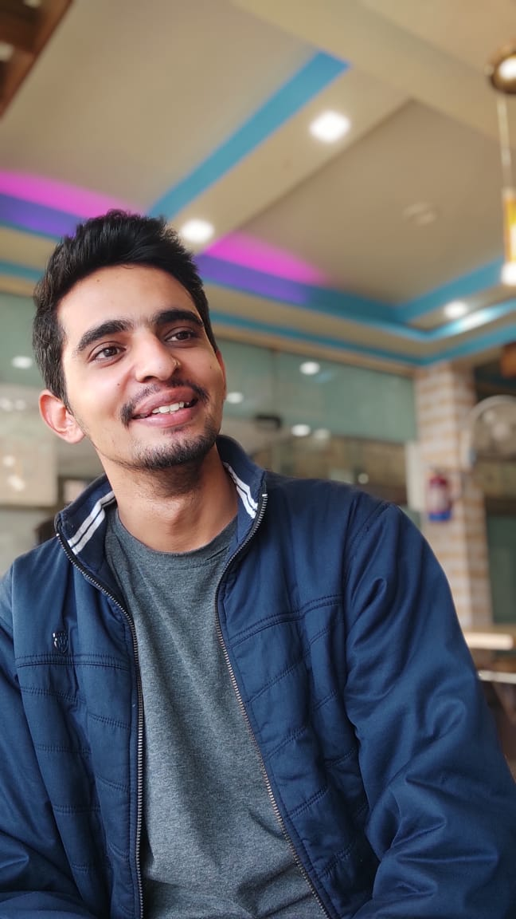
Team Presentation
RUDRA PRATAP SINGH MCA
(2 YEAR/3 SEM)
KIET GROUP OF INSTITUTION

Slide 4

HOW IDEA ARRIVES
Here comes the reason that how this idea arise. One day I was surfing the internet and reading an article related to the “Depression problems”, this makes me curious and then I read how depression occur? And how to prevent it? Then I thought can we contribute to prevent it ? with the help of technology. Then this whatsapp mood detection arise.
“save lives with the help of social media"

Slide 5
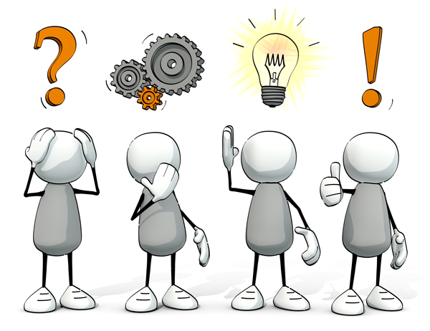
WHY DO WE NEED THIS SYSTEM?
Y
Make relations stronger
Saving lives and mis happenings in our surroundings
To understand your loved ones better
To prevent depression in early stages
WHY?

Slide 6

How Dangerous Depression can be?
Y
Depression is a common mental disorder. Globally, it is estimated that 5.0% of adults suffer from depression.
Depression is a leading cause of disability worldwide
It is a major contributor to the overall global burden of disease.
More women are affected by depression than men.
Depression can lead to suicide.
There is effective treatment for mild, moderate, and severe depression.
WHO Report

Slide 7
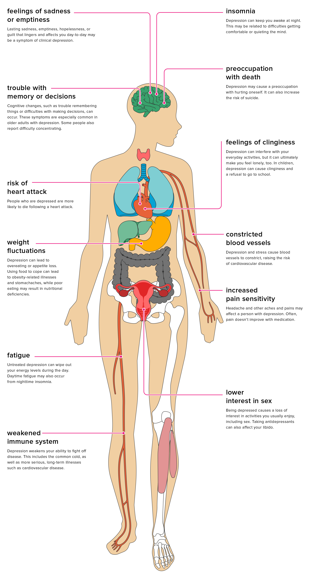
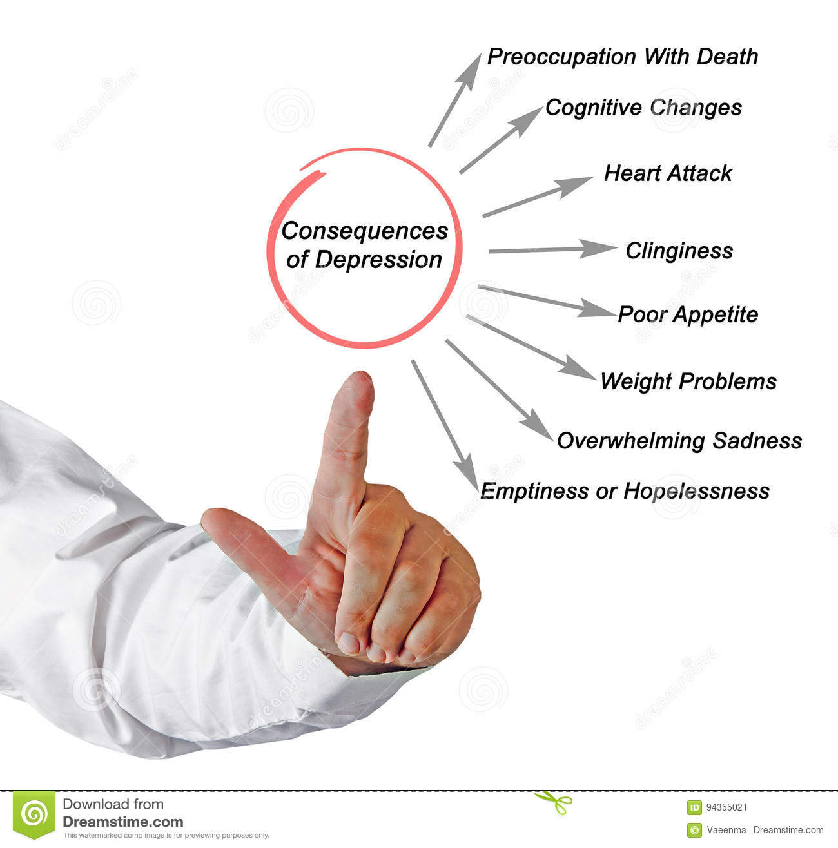
Consequences of Depression
Y
WHY?

Slide 8
Y
WHY?

Slide 9
Y
WHY?

Slide 10
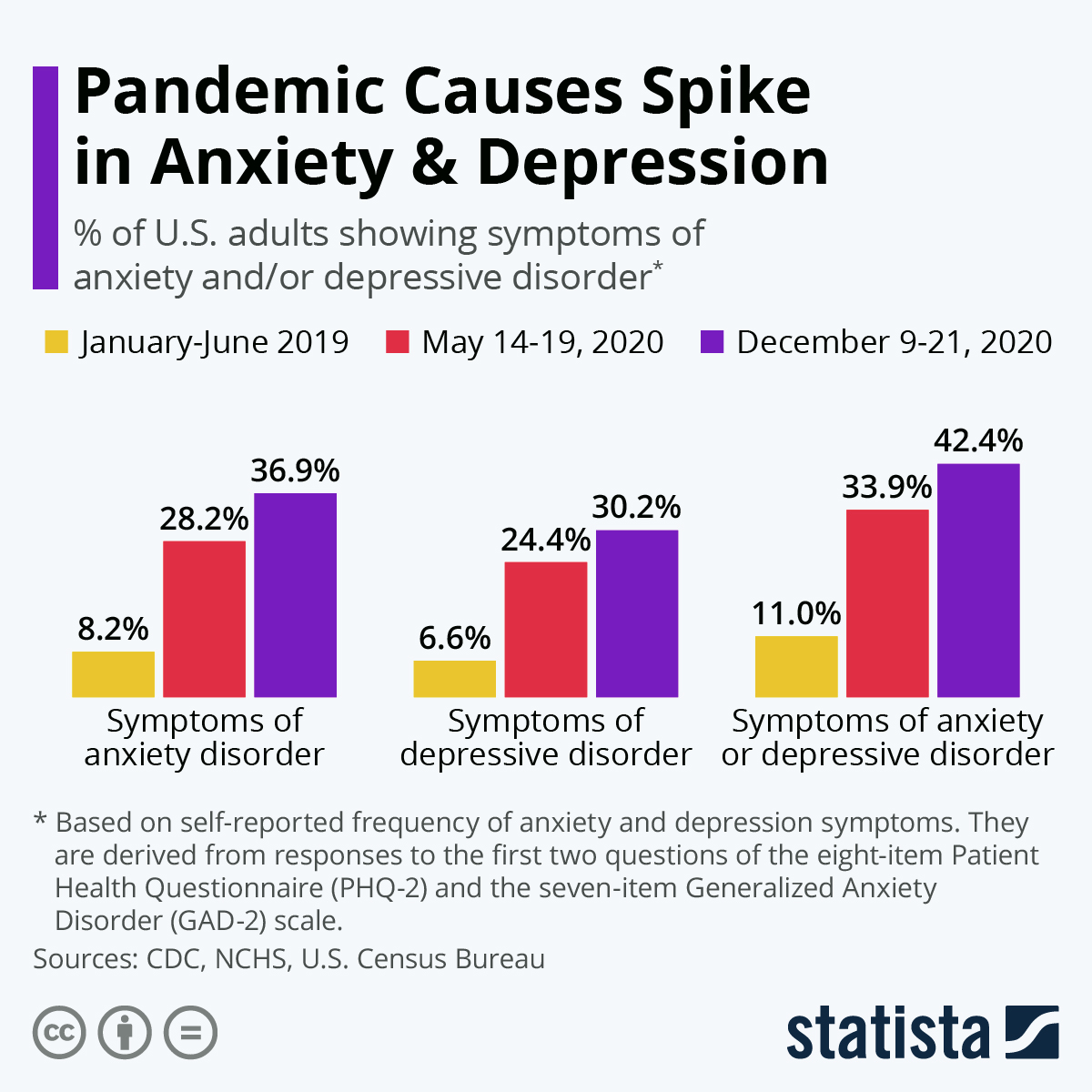

Y
WHO Report

Slide 11
Depression statistics
Y
WHO Report

Slide 12
How Dangerous Depression can be?
Y
Reference:
Institute of Health Metrics and Evaluation. Global Health Data Exchange (GHDx). http://ghdx.healthdata.org/gbd-results-tool?params=gbd-api-2019-permalink/d780dffbe8a381b25e1416884959e88b (Accessed 1 May 2021).
Evans-Lacko S, Aguilar-Gaxiola S, Al-Hamzawi A, et al. Socio-economic variations in the mental health treatment gap for people with anxiety, mood, and substance use disorders: results from the WHO World Mental Health (WMH) surveys. Psychol Med. 2018;48(9):1560-1571.
WHO Report

Slide 13

PROJECT GOALS
Our main goals of this project is to create such an application or system which will alert us when something wrong when it detect something suspicious through whatsapp status, now a question may arise how ? Through the Whatsapp text statuses and we'll process the statuses through machine learning algorithms and pick some words out of it and on the basis of those words application will alert.

Slide 14

FEATURES OF THE PROJECT
EASY TO USE
TIME SAVING
LIFE SAVING
COST EFFICIENT
MAKES RELATIONSHIPS STRONGER

Slide 15
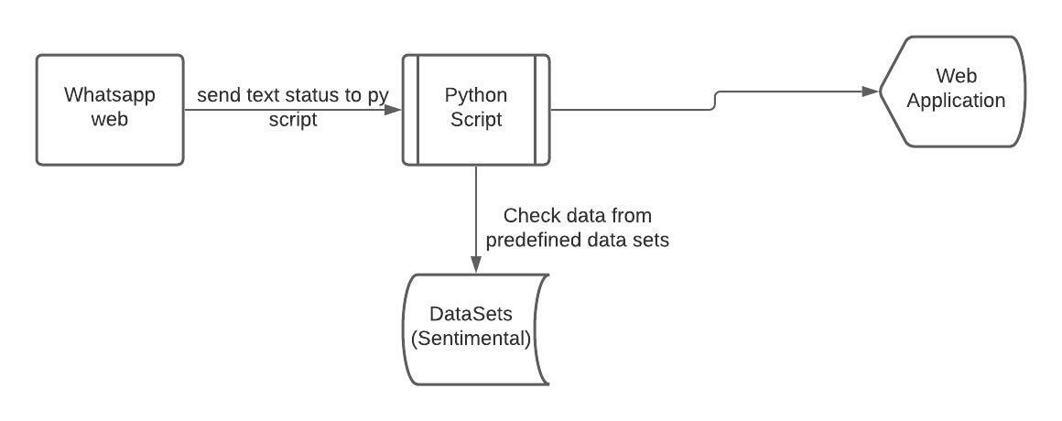
System Overview

Slide 16
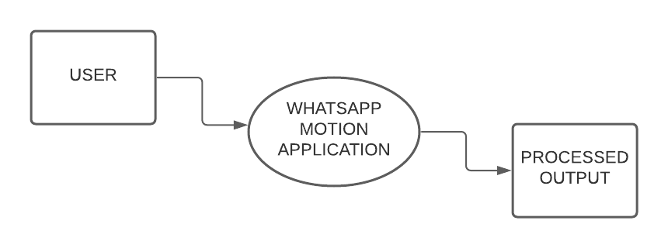
DFD: LEVEL 0

Slide 17
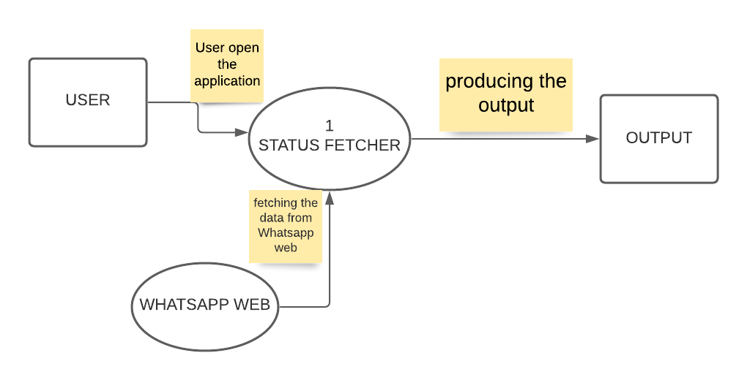
DFD: LEVEL 1

Slide 18
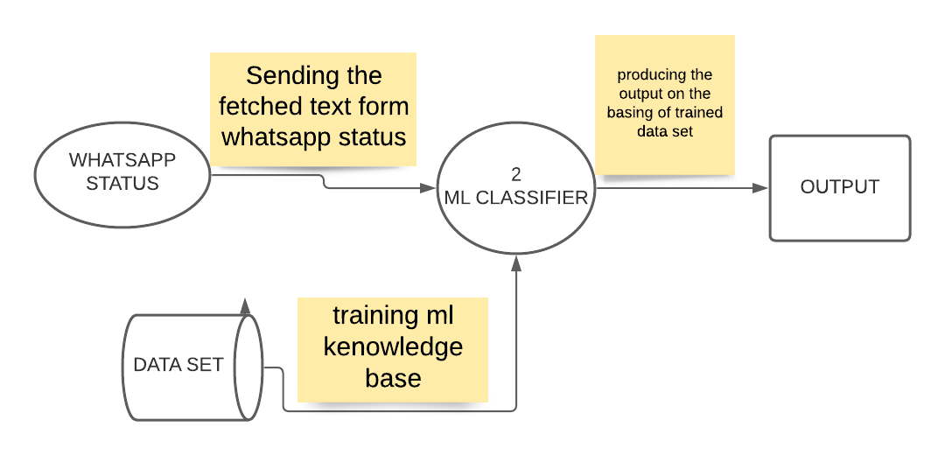
DFD: LEVEL 1

Slide 19
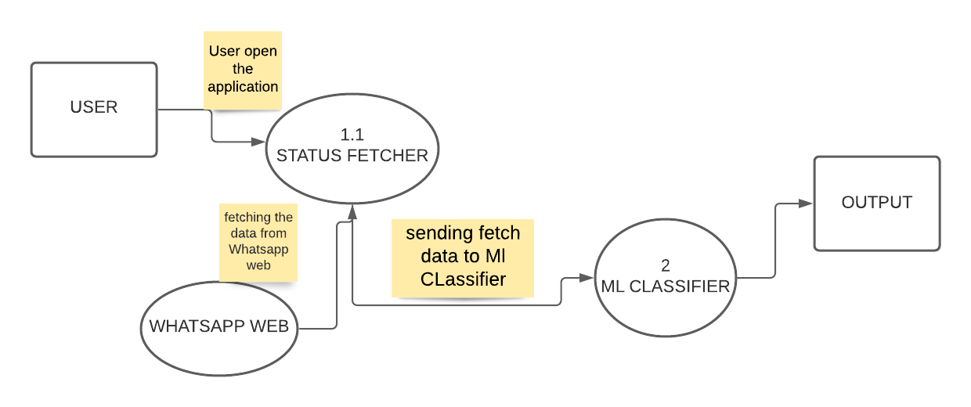
DFD: LEVEL 1

Slide 20
USER CASE DIAGRAM
In this use case diagram we are assuming both actor already loge din into the WhatsApp web
In this user case diagram there are two actor ACTOR 1, ACTOR 2, the actor one can login the WhatsApp web and check the status or actor one can open the status fetcher apo and the status fetcher app will automatically open the WhatsApp web and then script fetch the text form data from the WhatsApp web.
And then the fetched data will transfer into the machine learning algos and the after process it will passed to the web application
That will show the process output
And actor 2 will open the WhatsApp web and the put a WhatsApp status or see the WhatsApp status

Slide 21
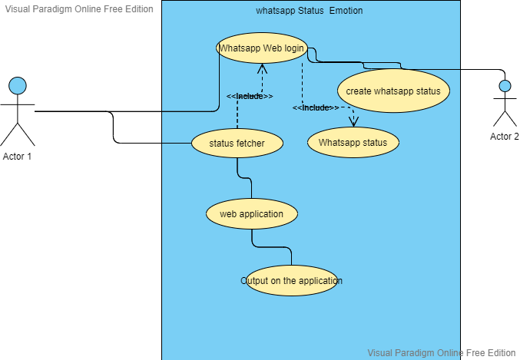
USER Case Diagram

Slide 22
HOW THE PROJECT WORK
Open the whatsapp web and our app
Start fetching the text status of the Whatsapp
We will get the processed result
1
3
5
2
4
6
SCAN THE
QR CODE to login
Then fetched data will processed
Call your love ones

Slide 23

TECHNOLOGY USED
IDE: VS Code, PyCharm
Programming Language: Python, selenium
Web Technologies: HTML,CSS,JS, Flask
Datasets : Google Dataset Search or Kaggle

Slide 24
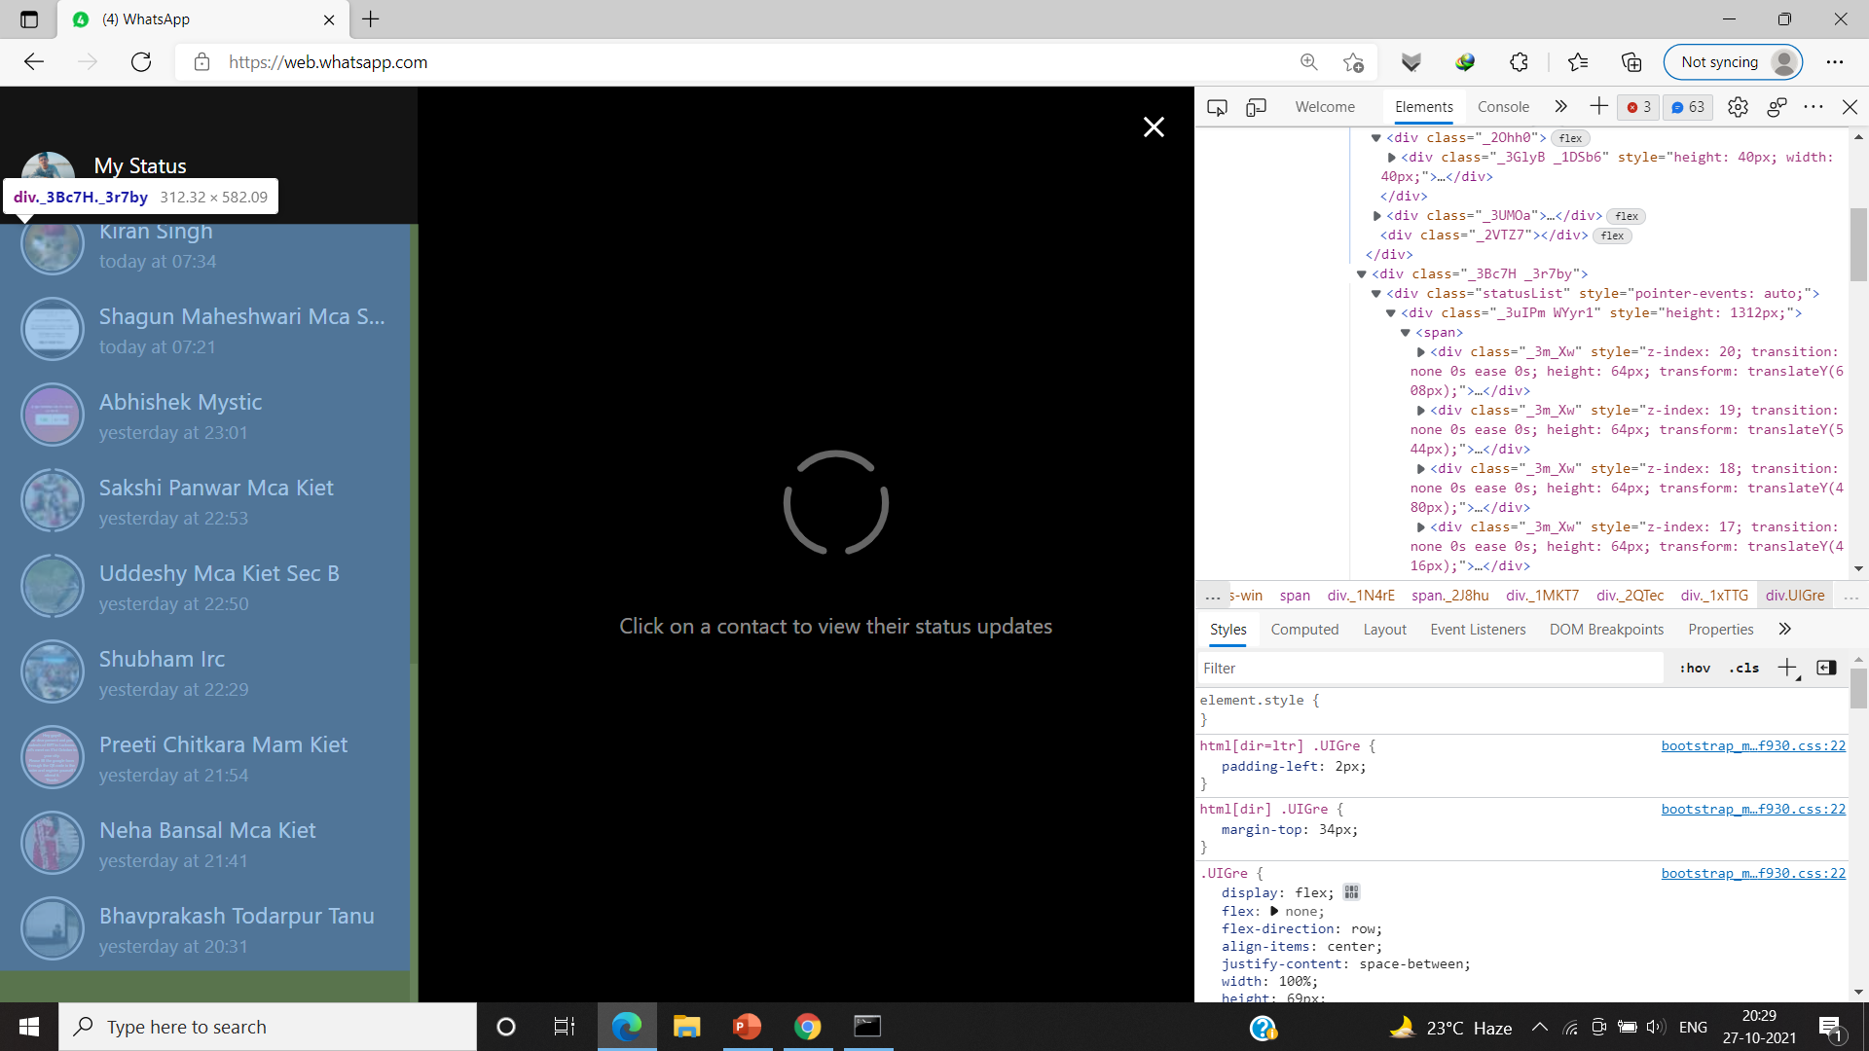

Slide 26
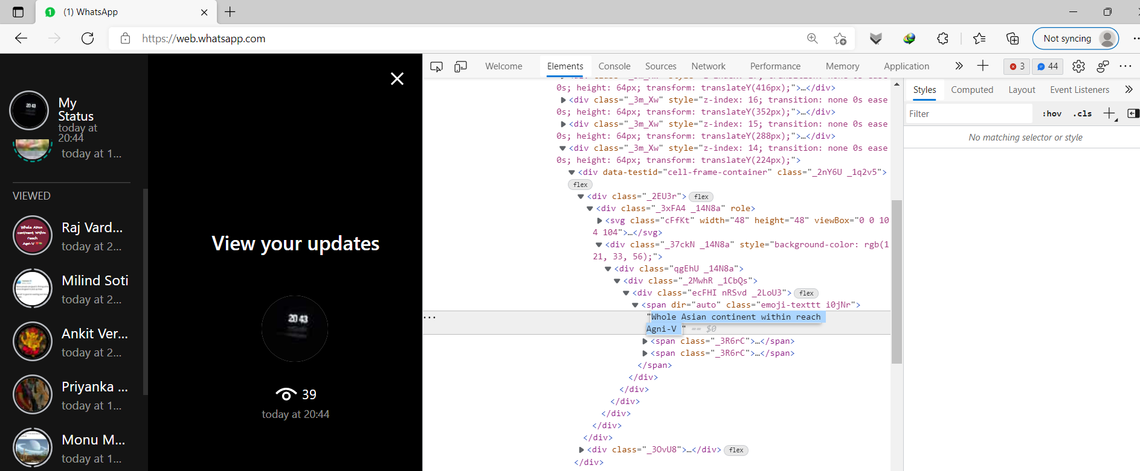

Slide 27
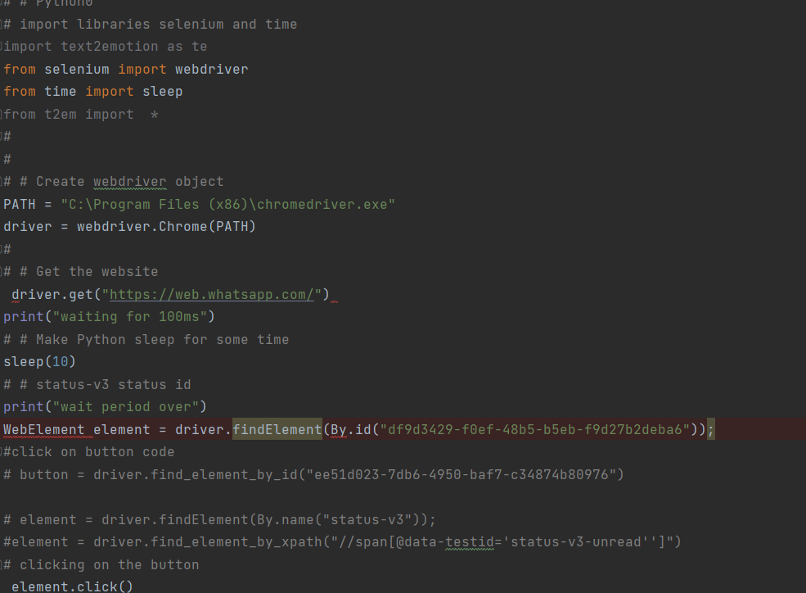

Slide 28
CUSTOMER
GRAPHICAL
USER
INTERFACE

Slide 29
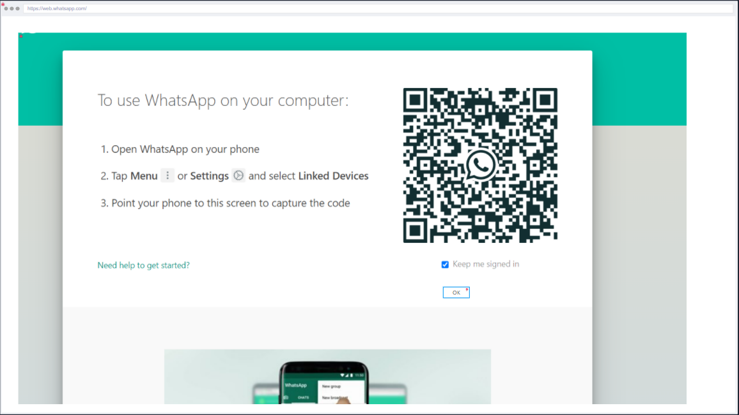

Slide 30
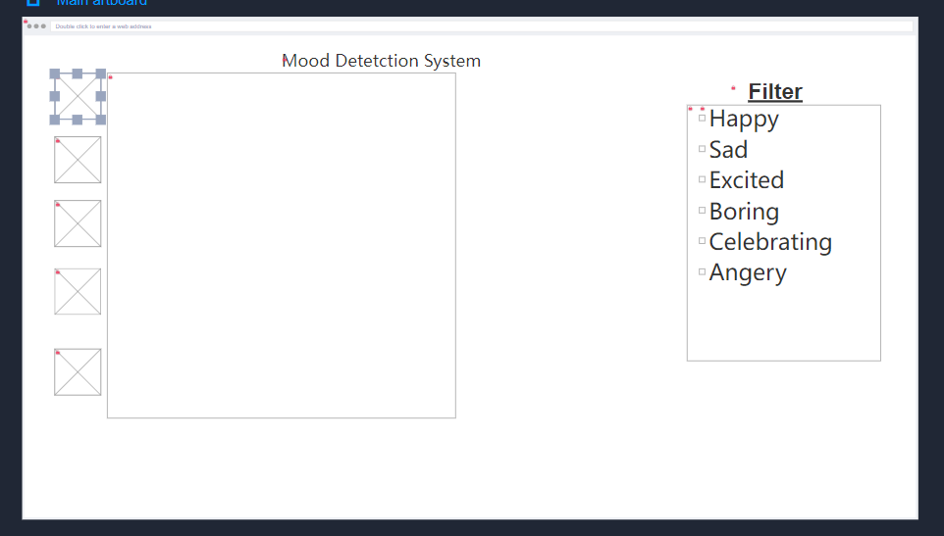

Slide 31
- Processes any textual message and recognize the emotions embedded in it.
- Compatible with 5 different emotion categories as Happy, Angry, Sad, Surprise and Fear.
Features
1. Text Pre-processing
At first we have the major goal to perform data cleaning and make the content suitable for emotion analysis.
- Remove the unwanted textual part from the message.
- Perform the natural language processing techniques.
- Bring out the well pre-processed text from the text pre-processing.
2. Emotion Investigation
Detect emotion from every word that we got from pre-processed text and take a count of it for further analytical process.
- Find the appropriate words that express emotions or feelings.
- Check the emotion category of each word.
- Store the count of emotions relevant to the words found.
3. Emotion Analysis
> After emotion investigation, there is the time of getting the significant output for the textual message we input earlier.
- The output will be in the form of dictionary.
- There will be keys as emotion categories and values as emotion score.
- Higher the score of a particular emotion category, we can conclude that the message belongs to that category.

Slide 32
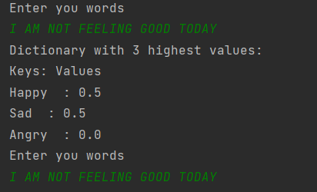
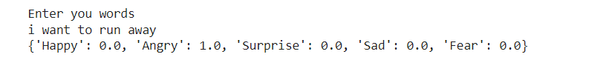
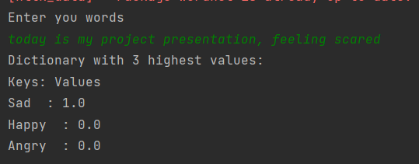
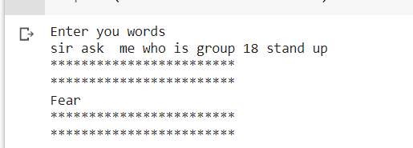
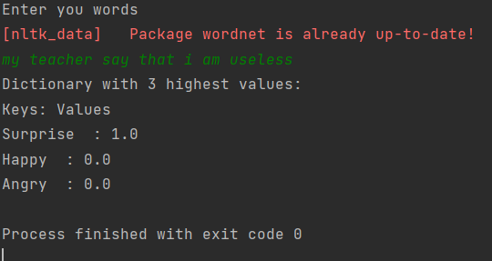
Results:

Slide 33

Future plans
Make an Mobile application.
Can make Browser extensions.
Able to get understanding from images and videos status.
Can be apply on other social media platforms.

Slide 34

Emotion Detection from text
Shiv Naresh Shivhare1 and Prof. Saritha Khethawat
Department of CSE and IT, Maulana Azad National Institute
of Technology, Bhopal, Madhya Pradesh, India
Emotion Detection and Recognition from Text Using Deep Learning
Chew-Yean
Microsoft Developer
Introduction to sentiment analysis: What is sentiment analysis
Emmanuel Lamptey Institute of Life and Earth Sciences (Including Health and Agriculture), Pan African University, University of Ibadan, Nigeria

Slide 35
OUTCOME
Research Papers

Slide 36
TIME FRAME (ESTIMATED)
Duration of project: 2 month=60 days
Analysis & Design duration= 30% of 60 days =16 days
Implementation: 50% of 60 days= 30 days
Testing & Debugging: 15% of 60 days = 10days
Extra reserve time : 5% of 60 days = 4 days
Total working hour: 56 * 4(Days *per day working hour)=224 Hours

Slide 37
THANKYOU!!
QUERIES ARE WELCOMED

